Slide 1

Transaction Data Analysis
Insights into State-wise and Temporal Trends

Slide 2
Introduction
Nu
Overview of the dataset: Transaction data across states, years, and months.
Objective: Identify distribution patterns, seasonal variations, and economic hubs.
Tools Used: Python (Pandas), Visualizations (Histograms, Bar Charts, etc.), T-tests.
Visual: A small sample of the dataset

Slide 3


Dataset Overview
Shape: 347 rows, 7 columns.
Columns: homestatecode, salestatecode,
month, year, txn_count, salestatename,
homestatename.
Data Types: 5 integers, 2 objects.
Time Period: February 2024 (based on sample data)

Slide 4

Preprocessing
No missing values (347 non-null entries for all columns).
Numeric columns checked for infinity/nan values and cleaned for analysis.
Focus on txn_count for statistical tests and visualizations.
Visual: A flowchart of preprocessing steps or a snippet of aa.info() output.

Slide 5

Transaction Distribution
Most transactions are below a certain threshold.
Few extreme values indicate outliers (e.g., 1012 transactions from Uttar Pradesh).
Visualized using histograms.

Slide 6

Temporal Trends
Data limited to February 2024 in this sample.
Potential for seasonal trends with more months/years (suggested by box plots).
Peaks and dips to be explored with extended data.
Visual: A line plot or box plot (placeholder, as full temporal data isn’t shown).

Slide 7
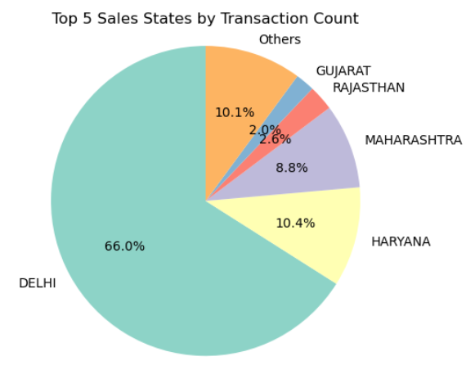
State-wise Contributions
High transaction states: Uttar Pradesh (1012), Gujarat (855), Madhya Pradesh (730).
Sales states like "Dadar & Nagar Haveli & Daman & Diu" show significant activity.
Economic hubs identified through transaction volume.
Visual: Bar chart of top 5 homestatename or salestatename by txn_count.

Slide 8
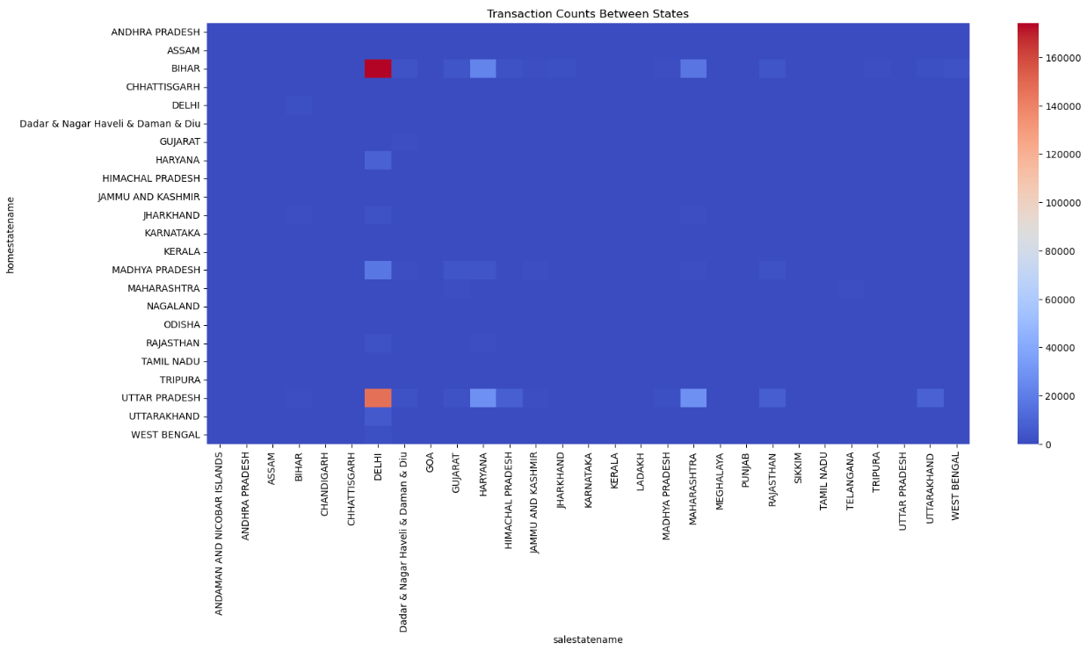
KEY FINDINGS
Transaction concentration in key states (e.g., Uttar Pradesh, Gujarat).
Potential seasonal patterns (needs more data).
No significant differences in T-tests between tested state pairs.
Economic hubs identified: High-transaction regions.
Visual: Map of India highlighting top states (e.g., Uttar Pradesh, Gujarat).

Slide 9
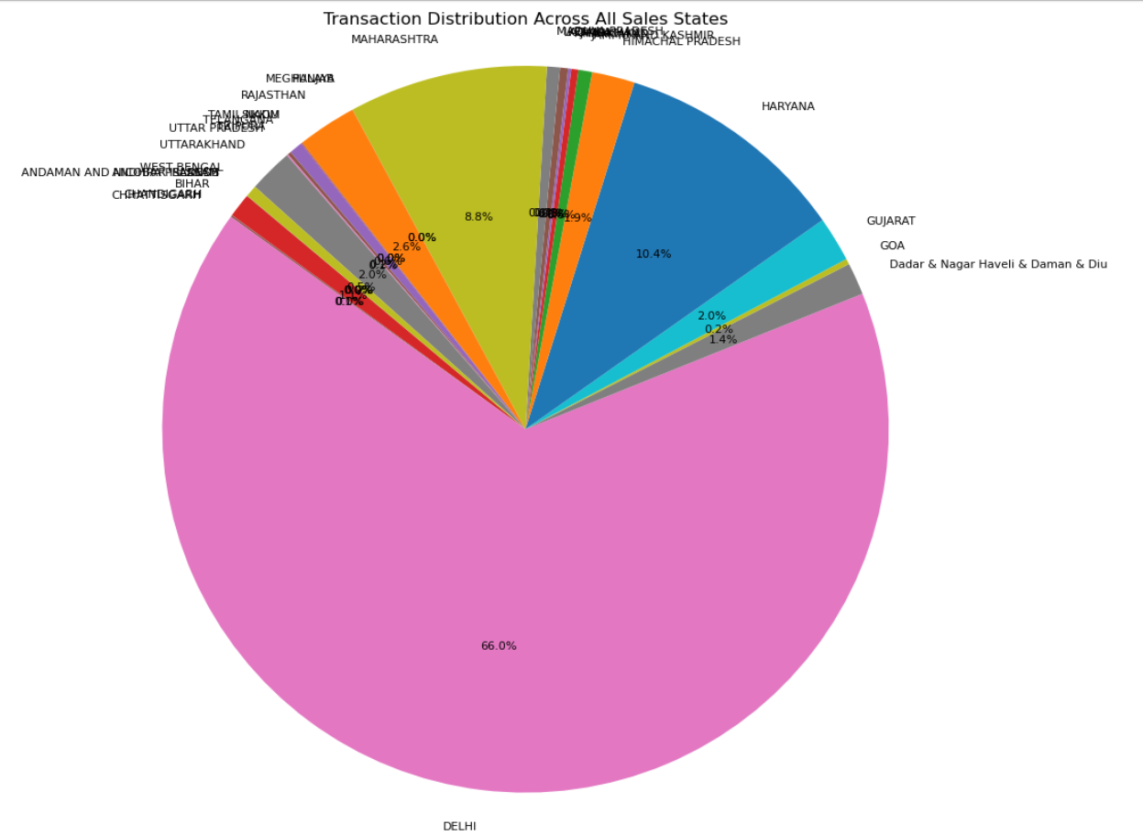
Conclusion
Insights into transaction behavior and state-wise trends.
Useful for forecasting and decision-making.
Future Work: Extend analysis with more months/years, additional statistical tests.

